Slide 1
Capabilities as Real Options
Bruce Kogut and
Nalin Kulatilaka
(2001)

Slide 2
Introduction
Strategizing is the application of heuristic frames to analyze the world and to generate normative evaluations of potential avenues of implementation.
What is the appropriate theoretical framing for strategizing?
Outward-looking perspective: market positioning and industry analysis.
Inward-looking perspective: firm choose their positions due to their own unique resources (RBV).
The core competence required to support a firm’s strategy results from the firm’s use of its resources.
What about the intersection?
What is neglected is that the value of those resources is determined by the market.

Slide 3
Structure of the paper
Characterize the value and limitations of heuristics.
Develop the use of real options as a heuristic and show how it is grounded in, and throws light on, three lines of thought of strategy:
RBV, Organizational Theory, and Complex Adaptive Systems.
Examine these ideas through a stylized mathematical description of the problem.
The formalization of this paper clarifies that the benefit of a real options heuristic is the imposition of a market test to derive the valuation of capabilities.

Slide 4
Strategy as Heuristic
Cognitive science suggests that a heuristic can be classified as its cognitive frame (solution space) and the rules of search (algorithms to find solutions).
Simon’s (1969) procedural search: due to the complexity of the problem, many heuristic algorithms provide "satisfactory”, but not clearly optimal solutions - the contexts may only be partially understood, leading to misapplication of the knowledge.
Since the environment stochastically changes over time, the strategic process, i.e., the choice of capabilities will have to be flexible enough to respond to opportunities.
A real option heuristic is a way to discern the value of particular paths of exploration in evolving environments.
Three elements are jointly required for the application of a real options heuristic: the provision of future managerial discretion to exercise the option (by definition), irreversibility and uncertainty.

Slide 5
Irreversibility
Irreversibility does not mean that firms cannot change; it is the timing of the change that matters:
The benefits of a transformation decline as competitors themselves adopt new capabilities;
Thus, irreversibility implies that the asset should be scarce and difficult to replicate in a timely way in order to support a strategy at a particular time.
A core competence is a scarce factor that embeds complex options on future opportunities.
But scarcity is not enough to determine the value of a competence. According to Real Options Theory, the identification of unique assets also relies on market valuations.
Thus, the firm’s position in the market will also matter in its search for a competitive position.

Slide 6
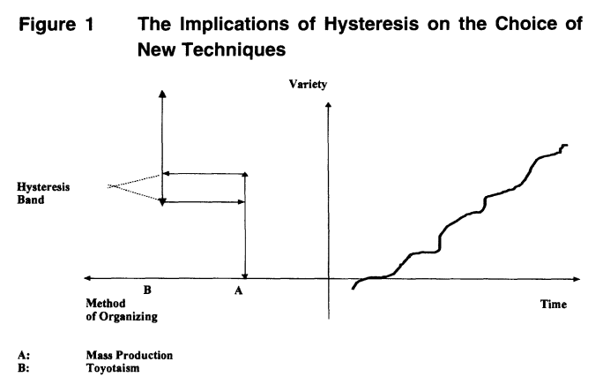
Uncertainty
Organizational theory has viewed uncertainty as threatening to the stability of organizations. The underlying reason is that increased risk might increase the hazard of death of an organization.
However, the Real Option model typically considers the upper boundary, or the probability of increasing growth by exercising options.
Those options result both from the external environment, and from the set-to-set correspondence between organizational practices and technologies.
Those attributes are tightly coupled and dynamically co-evolve, in such a way that organizational change becomes costly because it demands adaptations on both types.
*Hysteresis: the phenomenon in which the value of a physical property lags behind changes in the effect causing it.

Slide 7
Inertia
The notion of inertia poses the question of whether the benefits accruing from changes in the capability set offset the costs of change.
Depending on the type of uncertainty faced by the firm (smooth or granular environmental change), different types of capabilities will be preferred.
In modular environments under smooth change, firms might use local learning to find superior ways to combine its technological and organizational elements.
In granular and highly uncertain environments, generalists –organizations whose competences are robust across many future states of the world– will do better than specialists.
Hence, organizational ecology suggests an escape from the inward-looking bias: firms that build general platforms, capable of accounting for expectations regarding the evolution of the external environment, are more likely to survive and grow.

Slide 8
Complex Adaptive Systems and Radical Change
The value of changing resources and hence changing position requires an evaluation of the cost of change against the future unknown reward.
Facing landscape ruggedness, moving from one peak to another implies an architectural change.
Such change is no longer experimentation around individual modules but requires a complex redesign around new sets of technical and organizational elements.
This problem is, however, less severe because exploration permits the building of ridges between value peaks.
It is exactly the evaluation of this correspondence between exploration of new capabilities and the evolution of the market environment that is provided by the application of a real options heuristic.

Slide 9
A Formal Description
Pairing three concepts of scarce factors and the underlying asset, irreversibility and inertia, and the landscape ruggedness and option values, the authors formalize three main ideas:
The stickiness of organizational and technological combinations requires a notion of time, that is, of irreversibility as indicated by the dynamic market valuation of organizational assets.
Distance in discrete combinations results in a radical difference between learning and recombination of modules within a family of organization and technical elements, as opposed to between families.
Uncertainty can be decomposed into continuous and granular measures of change.
The formal description to understanding capabilities as an option has the important advantages of:
Clearly defining a core competence in reference to a market valuation;
Providing a clear statement of the trade-offs between learning and exploitation, on the one hand, and experimentation and exploration on the other.

Slide 10
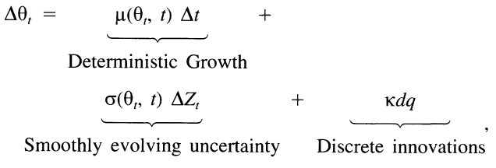

Looking Outside the Firm: Market Pricing
How should we value an investment in new capabilities?
The value of a capability depends not only on the internal assets, but also on how those assets are deployed, and on external market conditions.
Specifically, the value of the capability depends on its contribution to the price of product or factor prices whose risk is spanned by traded assets in the economy.
To evaluate it, we need to consider the evolution of its quality-adjusted price, $θ$, which is determined by local supply and demand conditions.

Slide 11
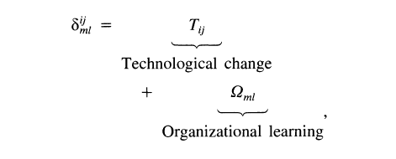
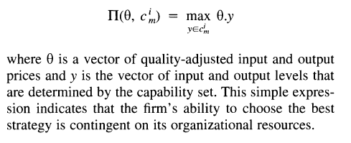
Looking Inside the Firm: Capability Sets
The firm’s problem is to decide what capabilities it should use in the current period. This decision is highly idiosyncratic, being connected to the specific characteristics of each organization. The alternatives usually involve:
Maintaining current capabilities;
Continuing in the same family of capabilities, but making incremental technological improvements, or;
Making a discontinuous organizational switch to a completely new type of technology.
The switching costs encompass: Profit maximization problem:
Combined with quality-adjusted input and output prices

Slide 12
Dynamic Valuation of the Critical Capability Set
When future values of $θ$ evolve stochastically, the current decision influences all future decisions as well, as represented by the following value function:
As the equation indicates, in each period the producer contemplates switching into a new capability set. If the producer switches, it realizes new benefits function, but pays switching costs. The presence of switching costs makes a forward-looking analysis necessary. Thus, at every period, the producer chooses the capability that maximizes the value of the project – a dynamic capability choice:

Slide 13
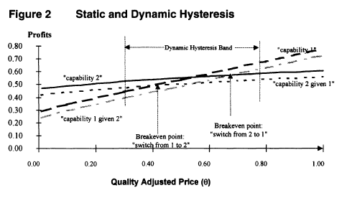

Tradeoffs and switching points
Inertia needs not be the consequence of myopia but is itself sensitive to environmental turbulence and to a firm's competence.
A more competent firm is, ironically, more subject to inertia. By staying in its current activities, the firm becomes increasingly more competent.
However, the danger remains that $θ$ will suddenly jump to a range or cross a critical threshold in which the firm's competence is no longer profitable $⟶$ competency trap.

Slide 14
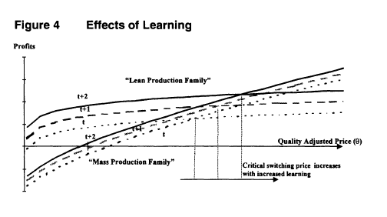
Avoiding competency traps
To speed its transition to new techniques and avoid competency traps, the firm may decide proactively to allocate funding to exploration by experimenting with new techniques.
This diversion of resources slows down its accumulation of learning with the current technology but increases the value of the option to switch to new capabilities by lowering the costs of switching.
By exploring potential recombination of assets, the firm reduces the costs to successfully adopt radical change in its capabilities.

Slide 15
Conclusion
Real Option Analysis provides the theoretical foundations to the use of heuristics for deriving capabilities. Through conditioning an understanding of competence in relation to a market test, it identifies the coupling of organization and technology as the leading explanation for the irreversibility of investments in capabilities.
According to the approach, because organizations consist of these coupled systems, the value of the firm is not reflected in the present value of its constituent parts, but in the potential of deploying capabilities for innovation in existing markets or for addressing new markets.
Thus, the options approach allows firms to “construct exploratory ridges between peaks” to hedge against adverse changes in the landscape, thus dealing with instead of avoiding risk.
Finally, it provides a reinterpretation of the concept of “core competence”: the core competence of the firm is the capability set (i.e., combination of organization and technology elements) that permits the firm to dynamically choose the optimal strategy for a given price realization of the strategic factor.

